Slide 1

A compact injection-locked UV laser system for quantum information processing
Nikolay Videnov
Quantum Information with Trapped Ions (QITI) Group

Slide 2
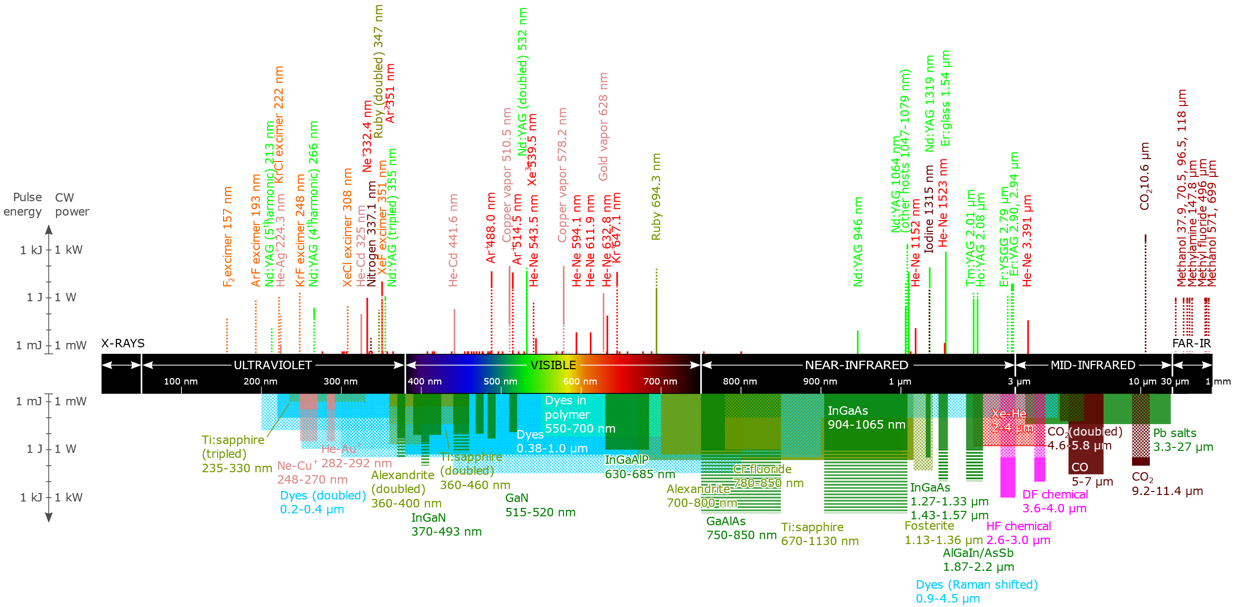
UV lasers
Uses
Micro lithography
Laser ablation
Trapped ions
Getting UV light
Frequency doubling Ti:sapph
ECDL laser
Injection locking

Slide 3

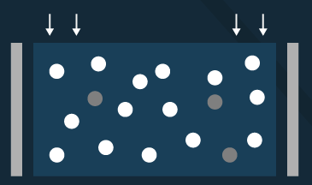
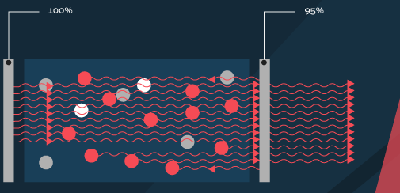
Injection Locking
Cavity laser
Gain medium electronically pumped
Saturation occurs forcing lasing
Injection locking
Inject seed signal
Above threshold power is diverted into injected singal

Slide 4
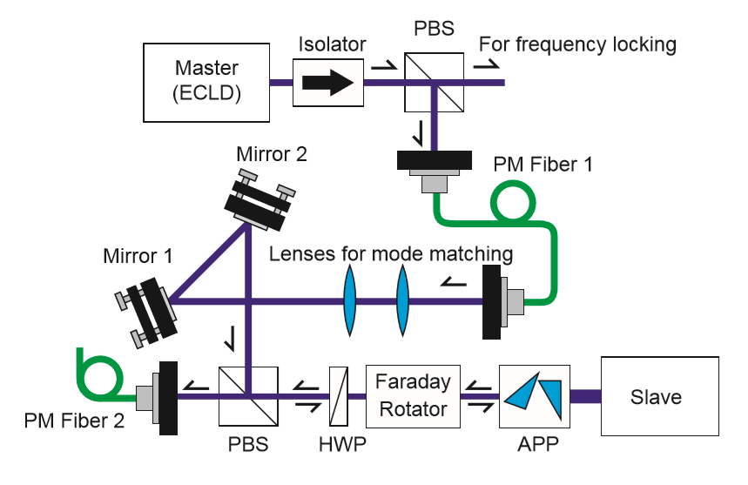
Physically realizing Injection Locking
Need a few mW from a seed laser
Faraday isolator
Slave laser diode
T. Hosoya et al., Review of Scientific Instruments 86, 2015

Slide 5
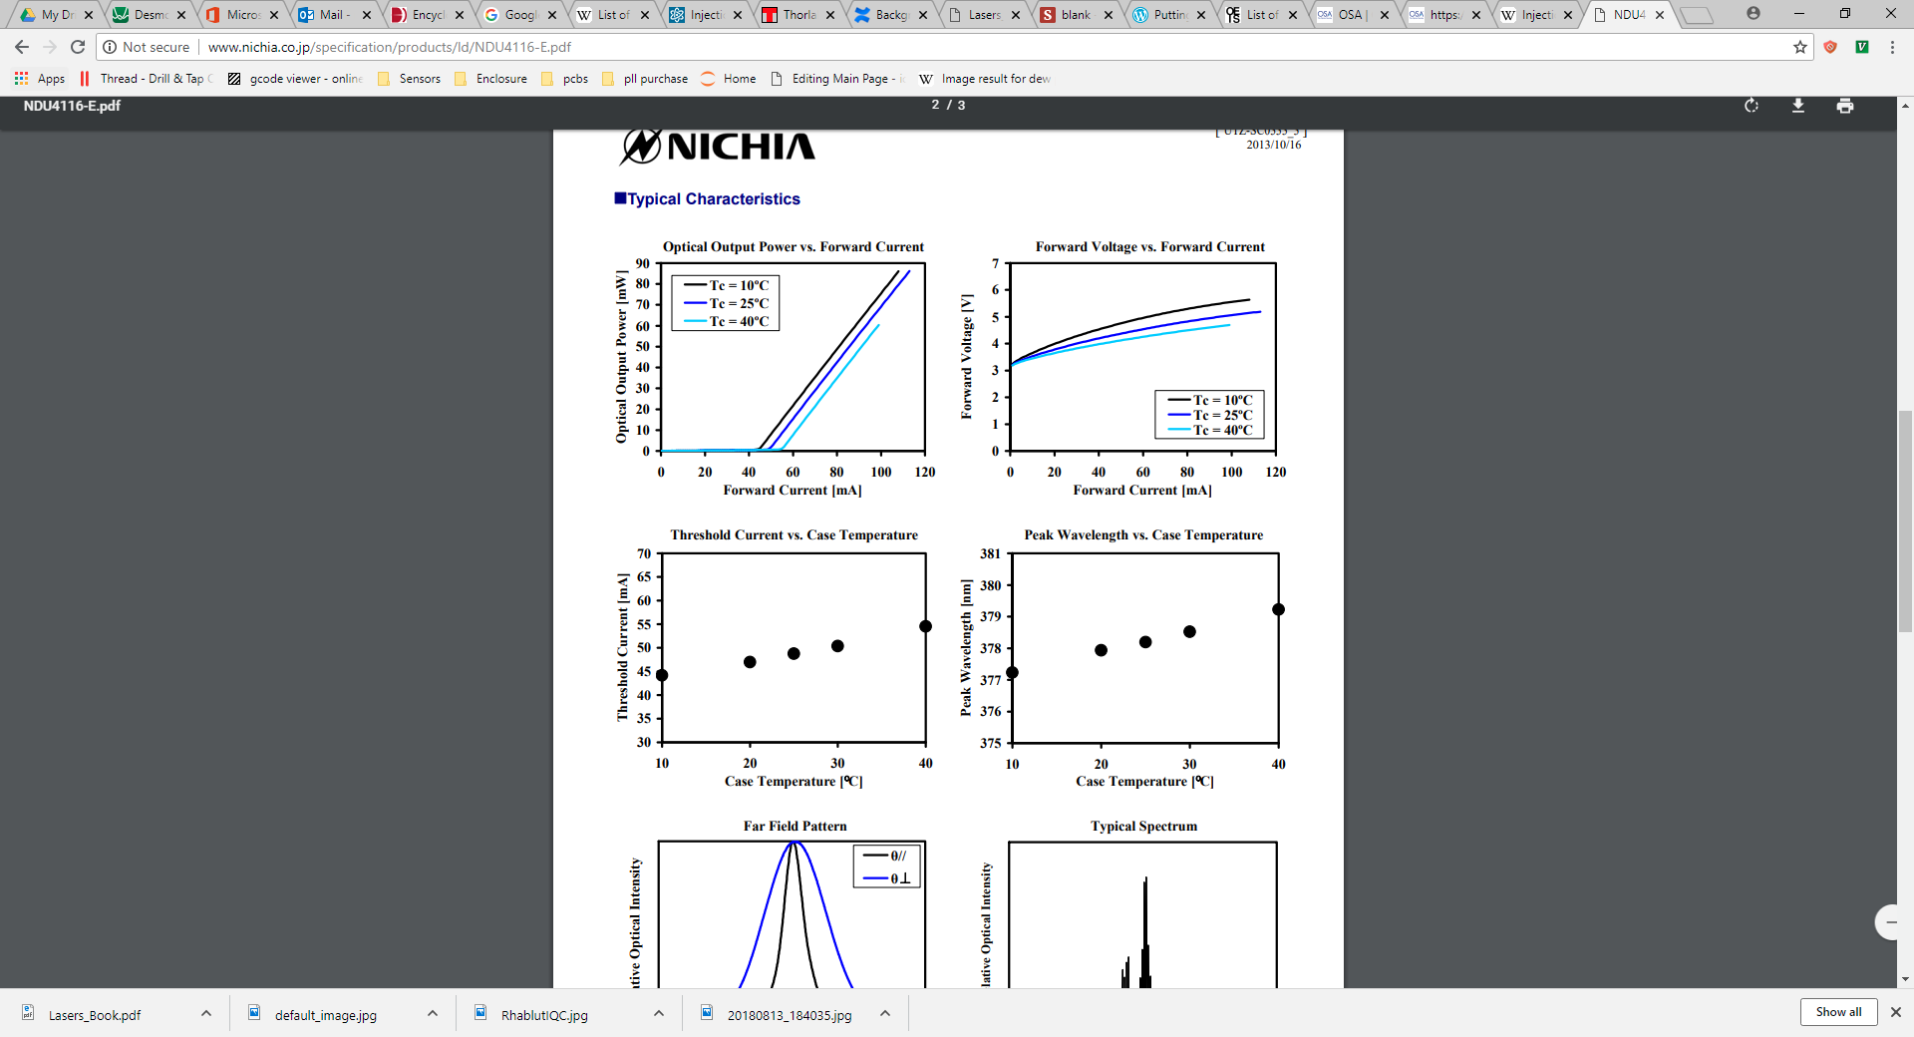
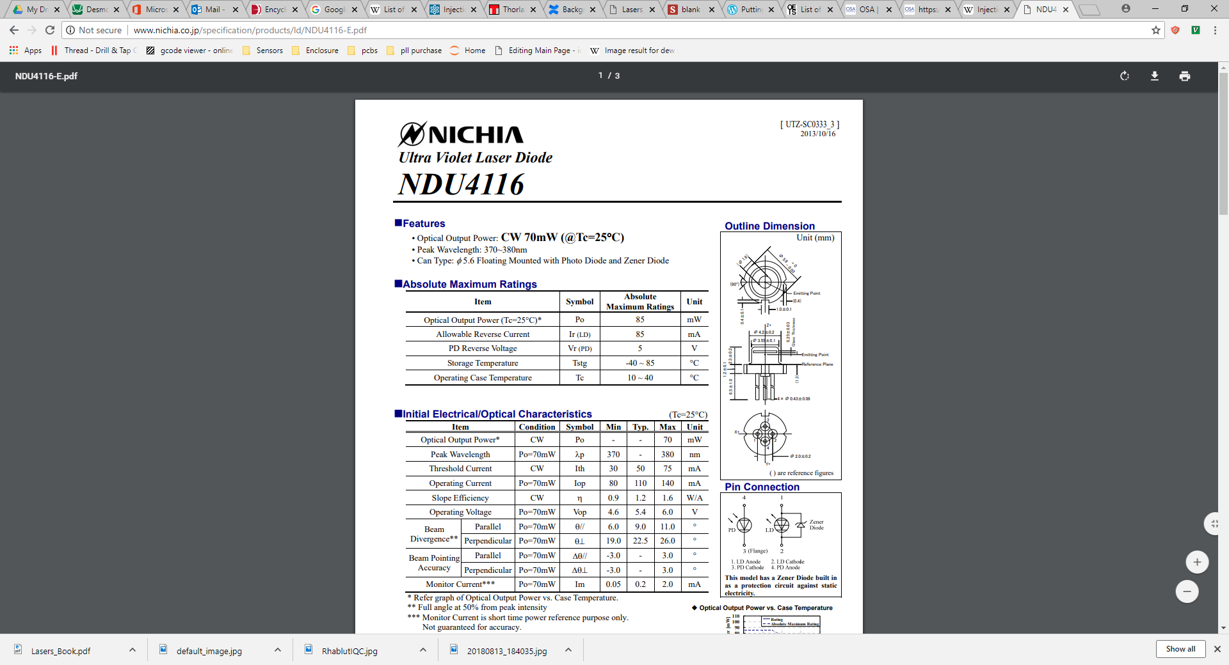
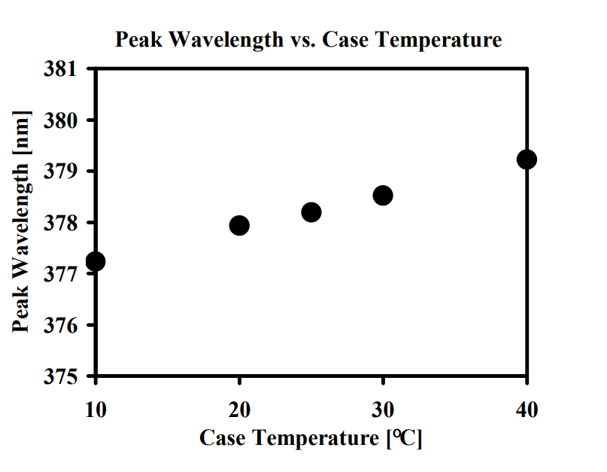
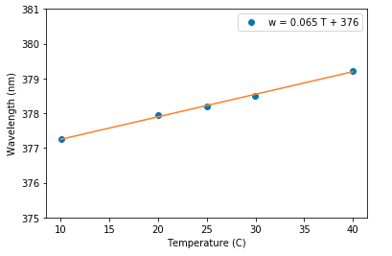
Diode Selection
Locking only happens around the free running oscillation frequency of the diode.
Need a laser diode around 369nm
The closest commercially available diode can be frequency selected to ~371nm*
Cool to 369nm?
*Nichia NDU4116 (370-380nm)

Slide 6
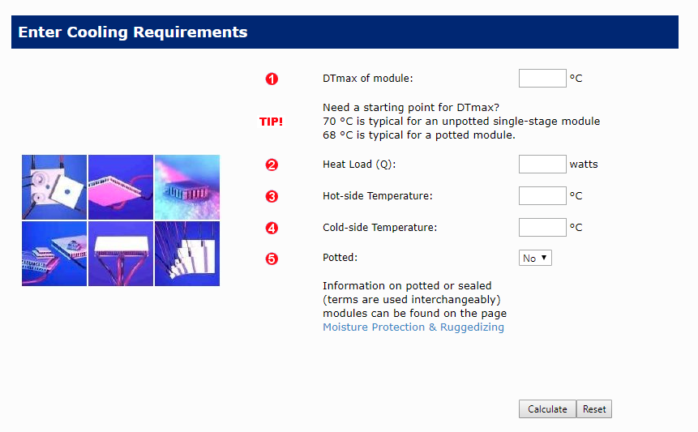
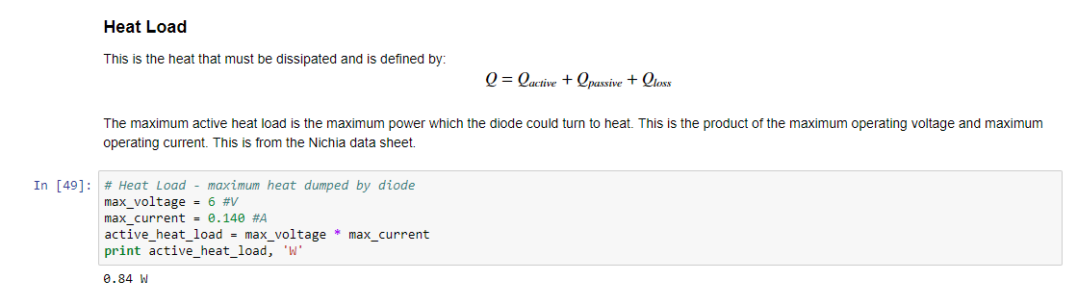
Cooling Laser Diode
40°C below lab temperature
Achievable with Thermoelectric Coolers (Peltier elements)
A few heat load calculations later we pick a pair of TECs

Slide 7
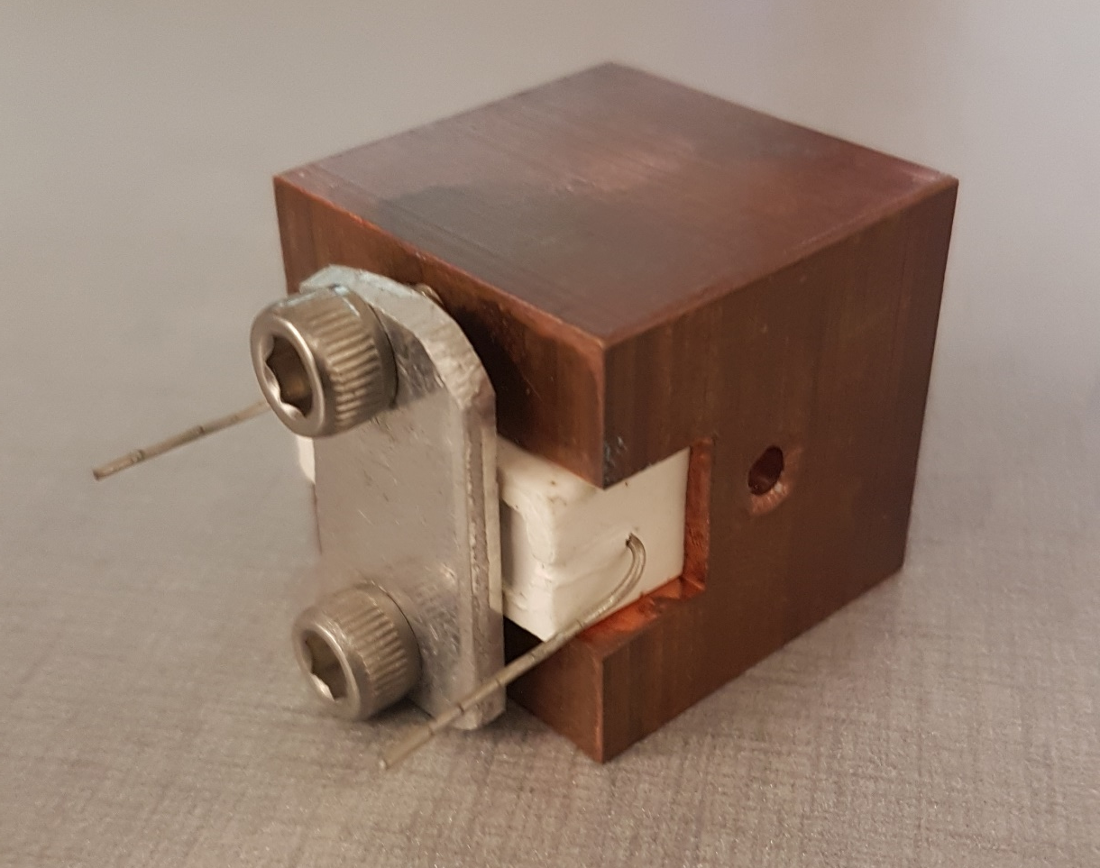

Slide 8
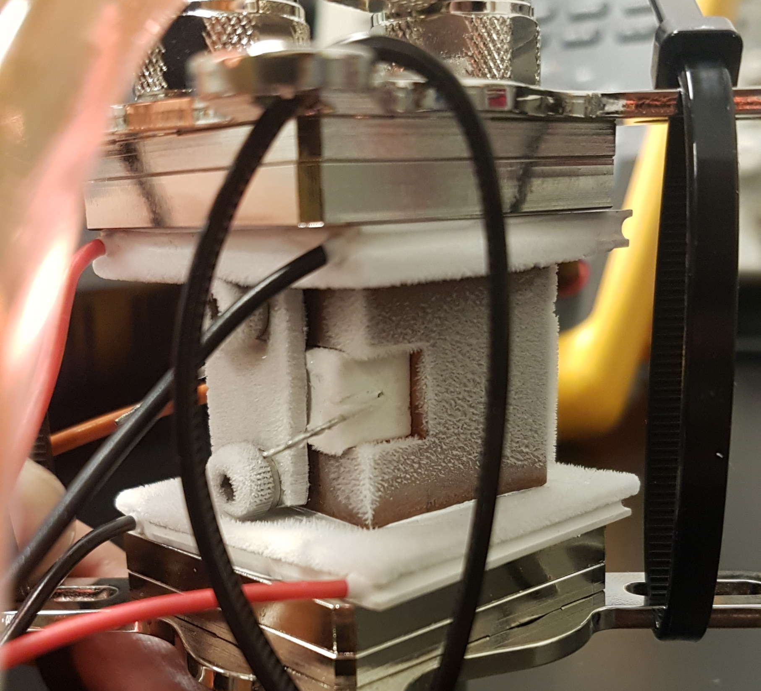
Laser Enclosure
Pressurize with dry nitrogen
Feedthroughs
Optical
Pressurized air
electrical

Slide 9
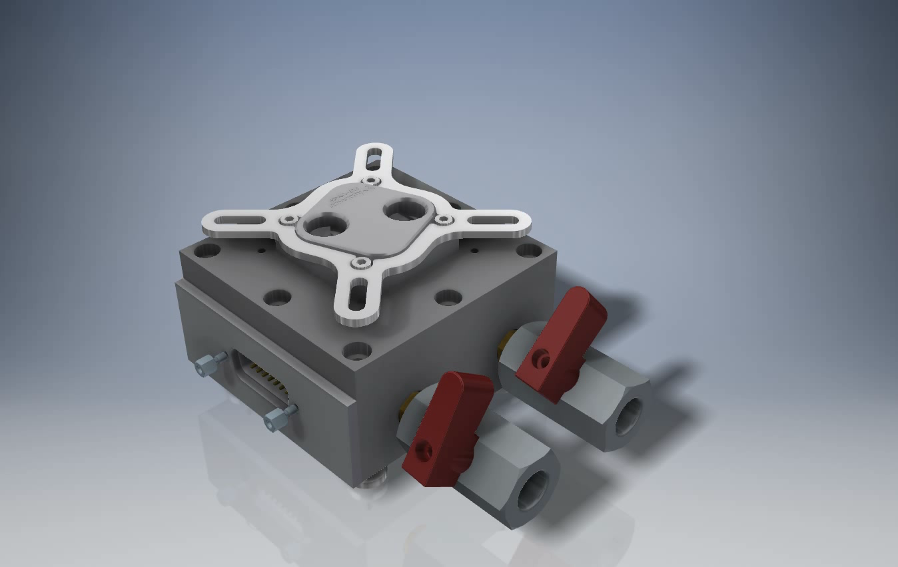

Slide 10
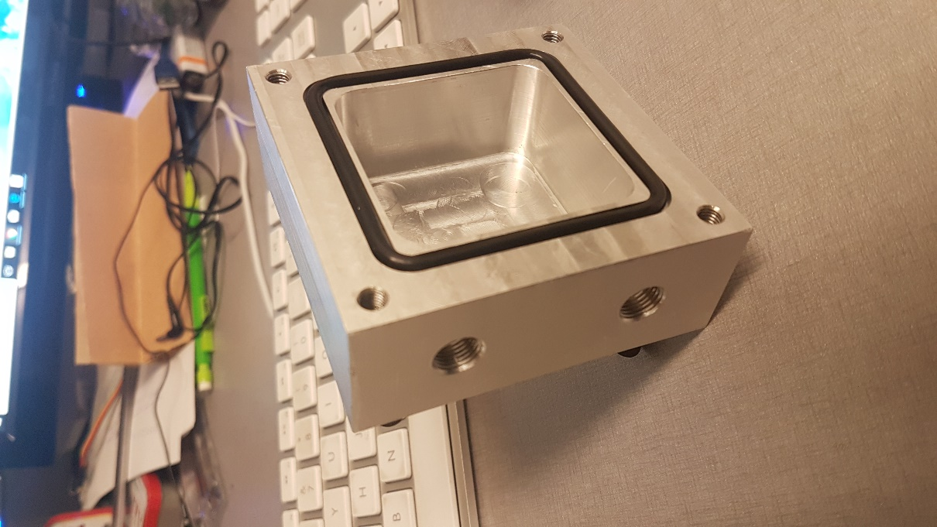
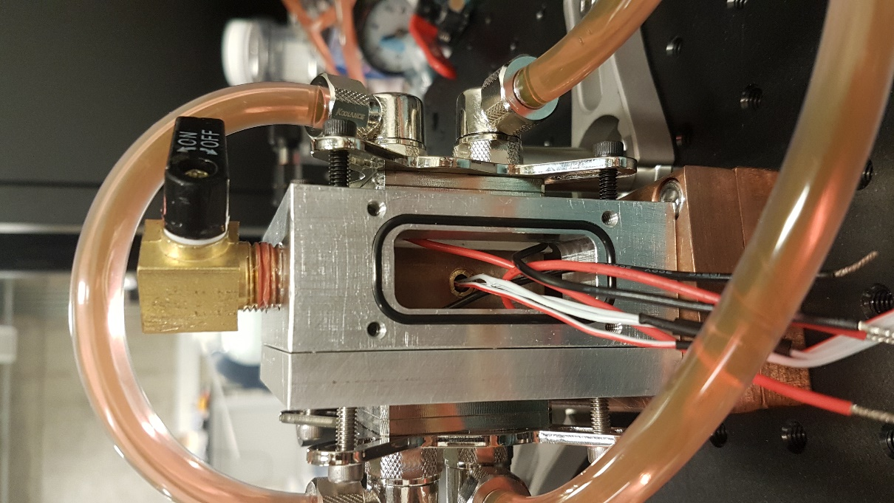
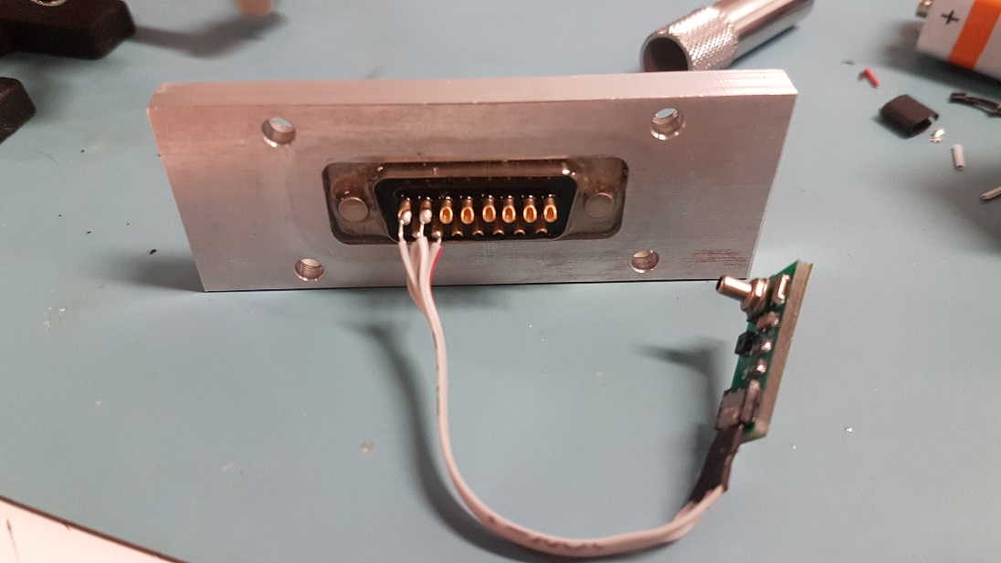

Slide 11
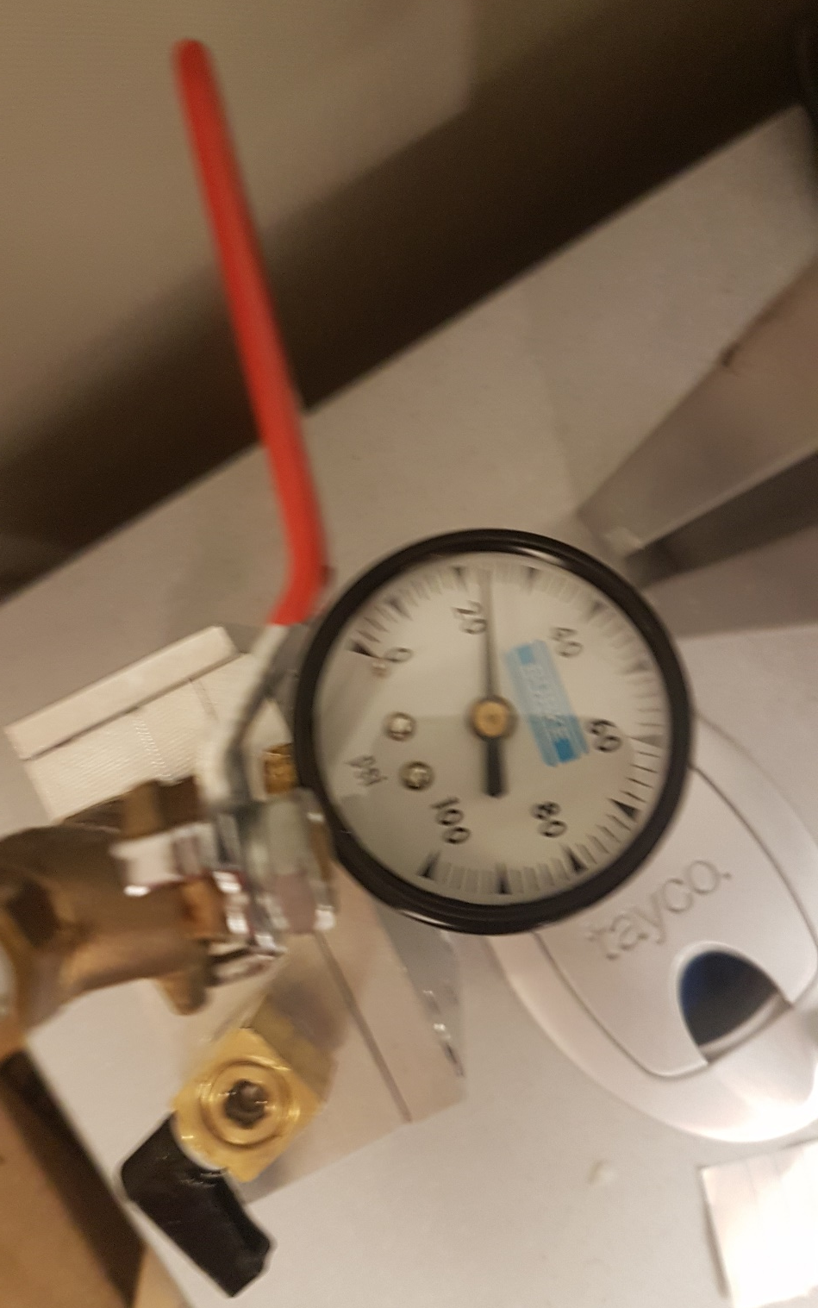
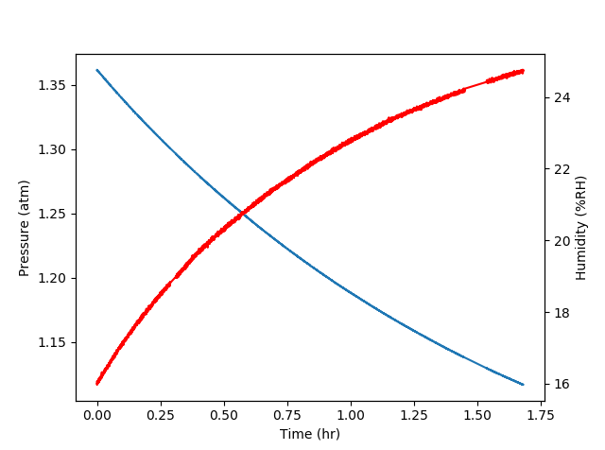
Climate Measurement
There’s a leak!
Make a blank and seal the D-sub connector

Slide 12
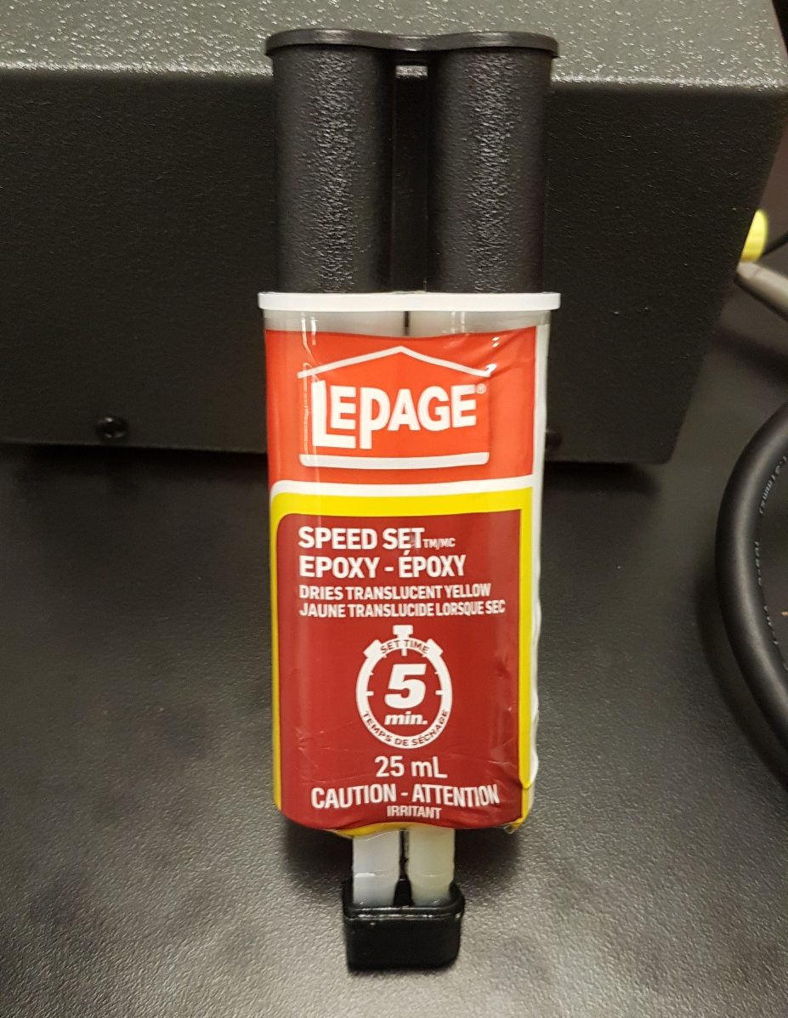
A fix all solution
5 minute epoxy
A measurable improvement!

Slide 13
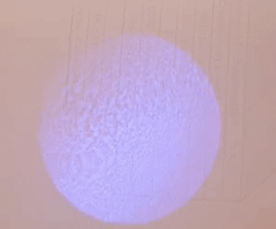
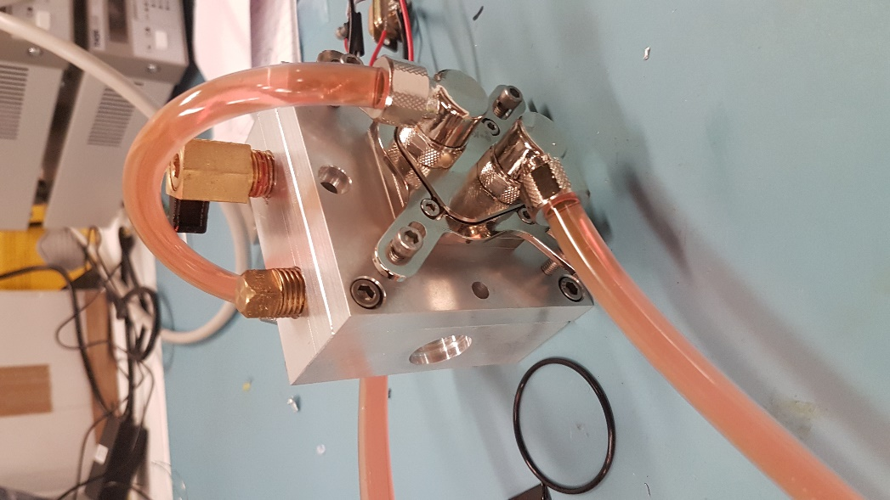
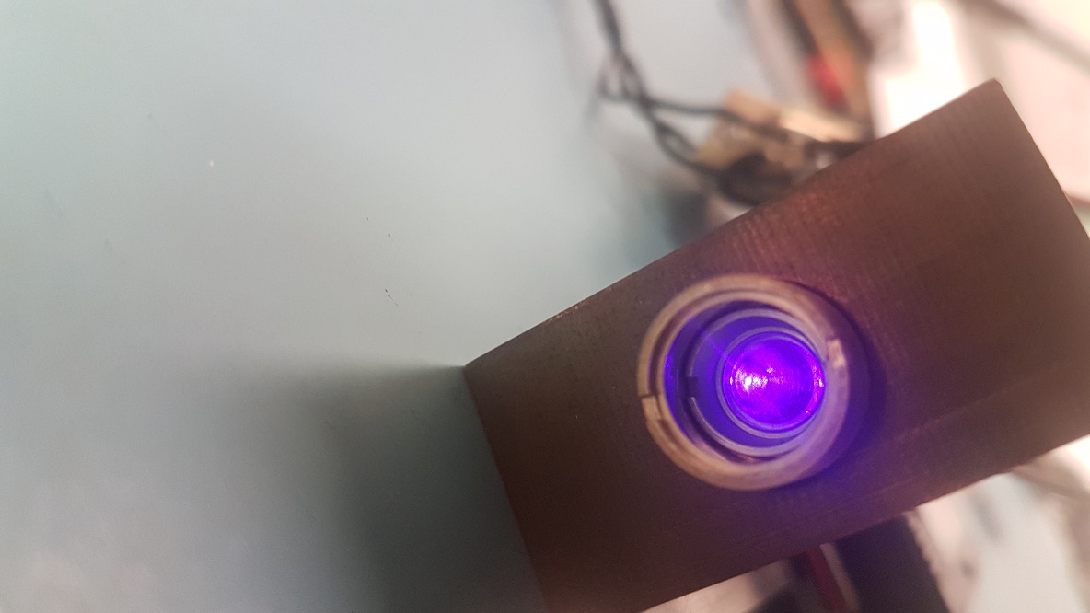
Putting it all together
Machined diode holder and enclosure
Compact collimation
Water-cooling
Constant current controller

Slide 14
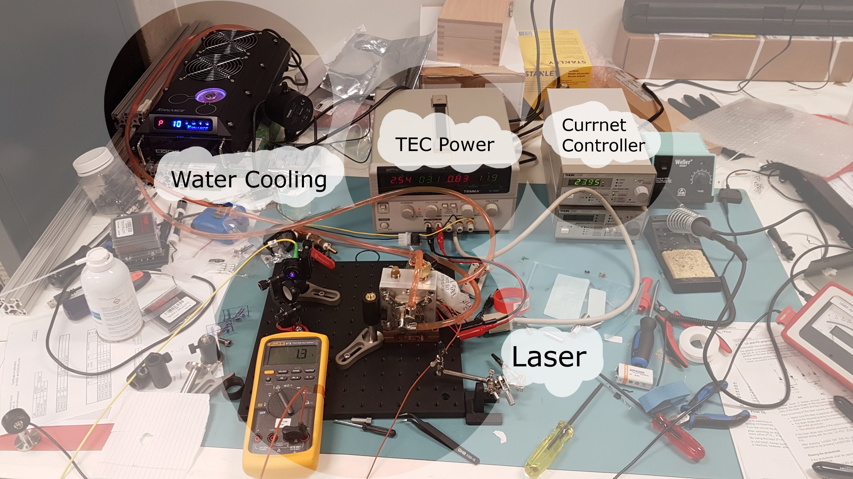
Experimental setup

Slide 15
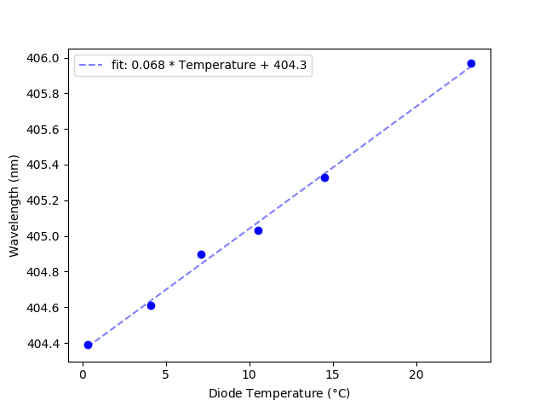
Results
Same slope from the datasheet
Effective cooling
Proof of concept

Slide 16
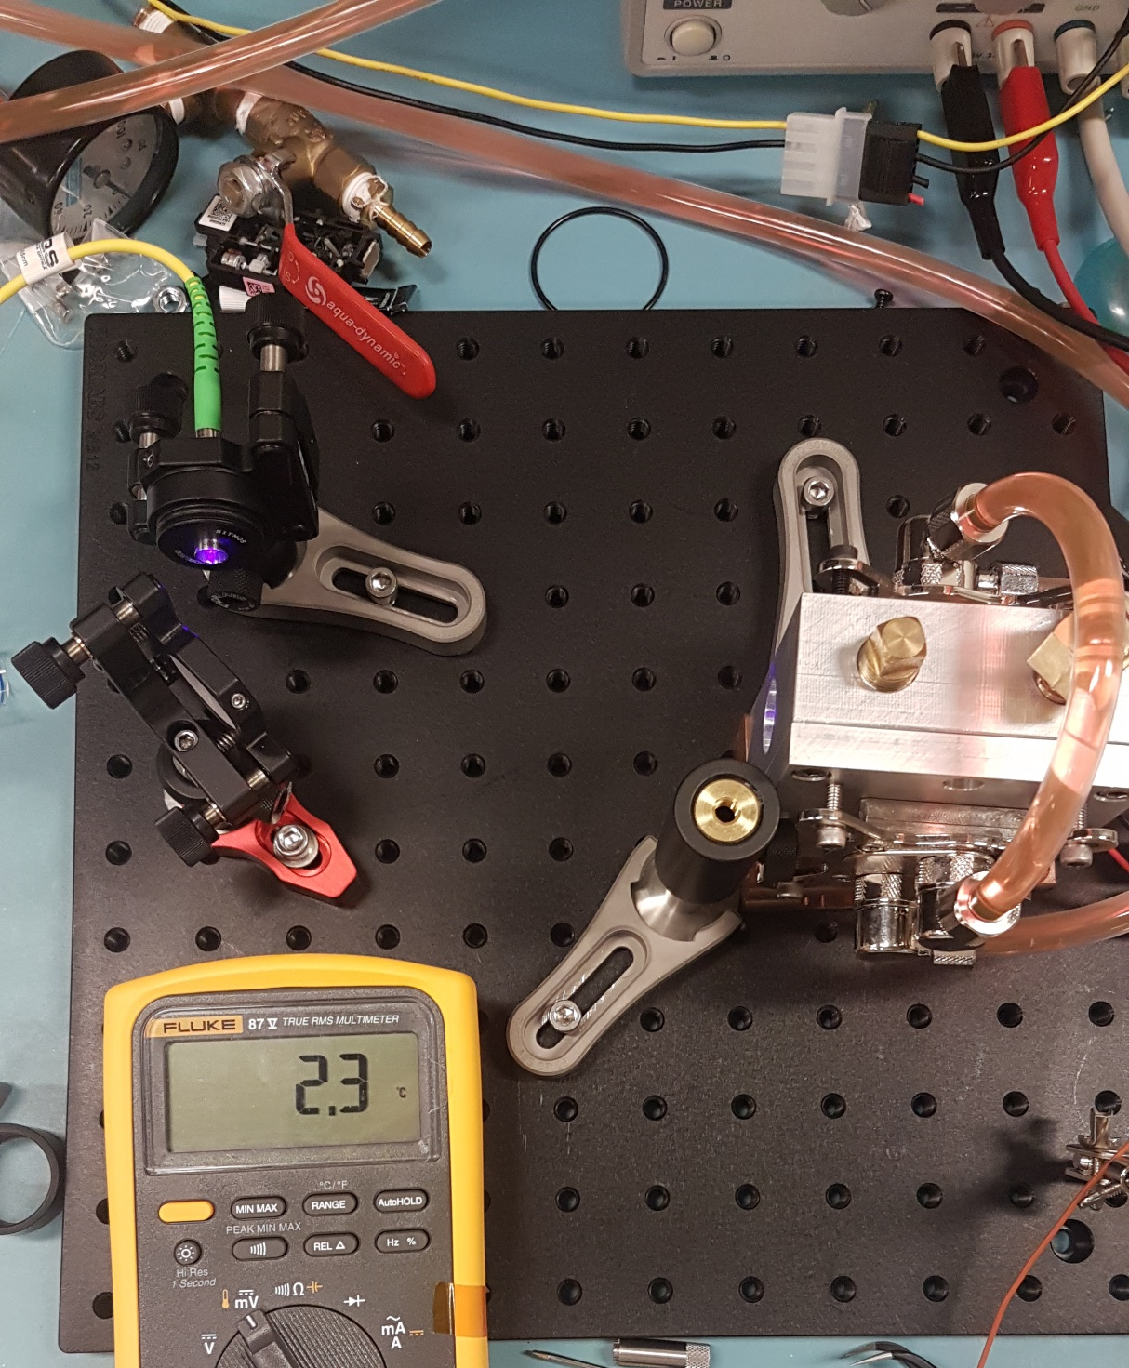
Conclusion/Outlook
Injection locking is an excellent way to amplify laser power
The challenges of injection locking can be tackled effectively with this design

Slide 17
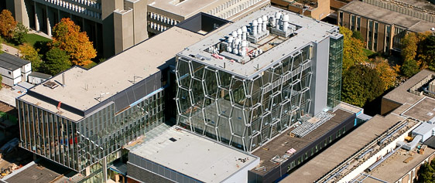



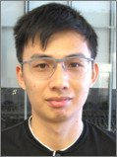



Quantum Information with Trapped Ions (QITI)
research.iqc.uwaterloo.ca/qiti/
Fereshteh Rajabi
Roland Hablützel
Chung-You (Gilbert) Shih
Nikhil Kotibhaskar
Sainath Motlakunta
Yi Hong
Teoh
P O S T D O C S
G R A D U A T E S T U D E N T S
U N D E R G R A D U A T E S

Slide 18
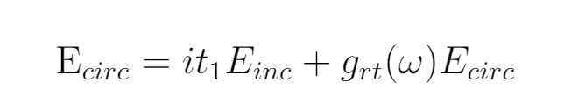
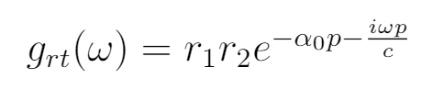
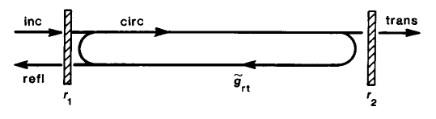
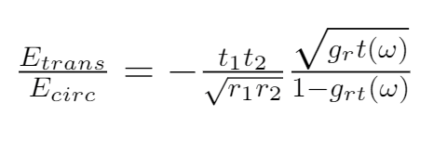
Injection Locking

Slide 19
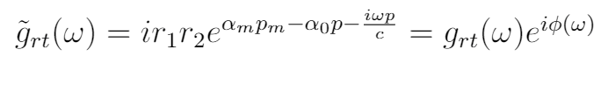
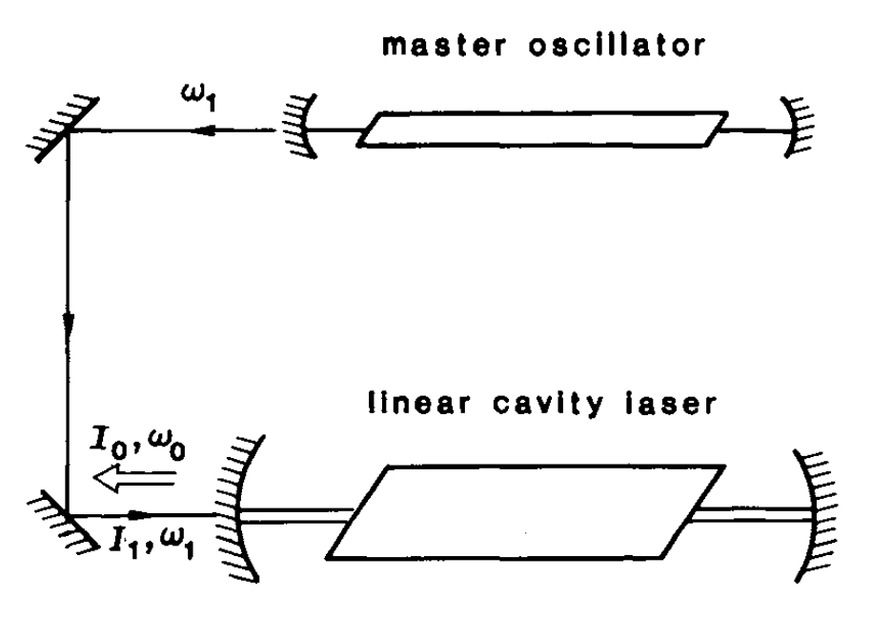
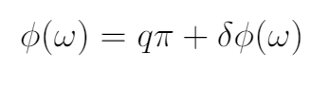
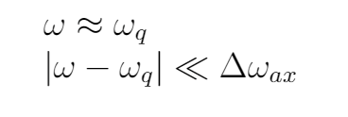
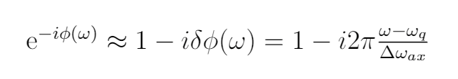

Slide 20
